Slide 1
Conversion of fingerprints using Inconsistent Cycle GANs

Slide 2
Objective
To convert user’s real fingerprint(RF) of a user into a fake fingerprint(FF)
FF should look like a real fingerprint and should not be detectable as a fake image
The similarity between RF of the user and his FF should be low. One should not be able to trace RF of a user from his FF.
Similarity between different impressions of RF and their corresponding FF should be maintained. These FFs should be similar. Intra user score preserved.
One RF of a user to be converted into multiple FFs. Each FF is to correspond to a unique key.
The similarity between RF and each FFs, and amongst each FFs has to be low. One should not be able to trace back other fingerprints from any one of the fingerprints.
The similarity between RFs of two different fingers and their corresponding FF should be maintained. These FFs should not be similar. Inter user score preserved.

Slide 3
Motivation
In case of security break and fingerprint leakage, user’s original fingerprints should not be compromised
Even if the architecture and the key associated with a user is leaked, one should not be able to trace back the real fingerprint of any user

Slide 4
Abstract
We use Cycle GANs to convert RF to FF of a user. The fingerprint type of RF and FF are different.
Cycle GANs preserve the inter user and intra user scores of fingerprint matching. They also result in FFs look real, with similar distortions and orientations as RFs.
We use the latent space of RFs to change the output image of Cycle GANs. A unique key is associated with each RF. The latent space of RF is modified using the key to prepare unique FF.
The key serves two purpose.
To provide a layer of protection in case of data leak. Even if the architecture is invertible, one will need the key associated with the user to trace back to his RF.
To associate multiple FFs with the same RF. One single RF can be changed to multiple FF using different keys. The user can be given different keys as per the requirement.

Slide 5
Abstract
Heat map is used to crop the FF. Cropping is required to remove noise outside the fingerprint, and to improve the difference score between user’s RF and FF. The center part of fingerprint impression which helps in fingerprint classification is used for subsequent steps.
During conversion, a random key is selected. The latent space of RF and key is input to the ResNet which changes the input latent space to the required FF type.
The ration in which to add the latent space of RF and key is optimized using linear regression.
The final output image has been tested using frequency spectrum for fake image detection.
Neural nets are used for the architecture, invertibility is not possible. RF of the user is thus safe.

Slide 6
Keywords
Fingerprints
Inconsistent Cycle GANs
Latent space
Resnet
Linear Regression
Gabor filter
Heat Map
Harris Corner Detection
VeriFinger
Frequency spectrum
Security
Anguli MSVC

Slide 7
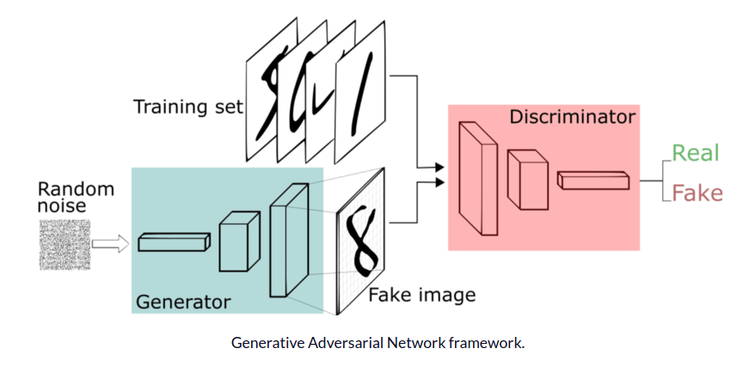
Cycle-GANs
Two neural net architectures work simultaneously.
One(generator G) creates fake image, another(discriminator D) differentiates fake image from real image.
The generator try maximizing the probability of making the discriminator mistakes its inputs as real.

Slide 8
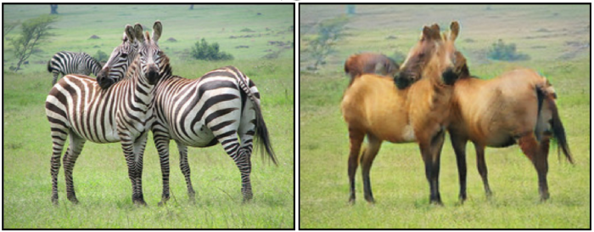
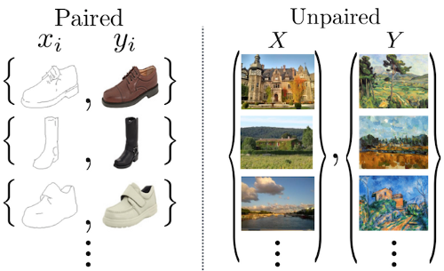
Image-to-image translation is the task of transforming an image from one domain (e.g., images of zebras), to another (e.g., images of horses)
We use unpaired dataset to train cycleGANs
No need of paired images

Slide 9
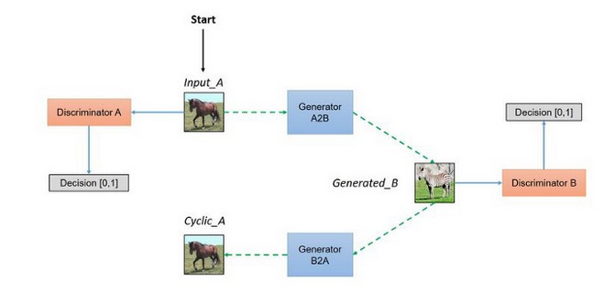
Block diagram

Slide 10
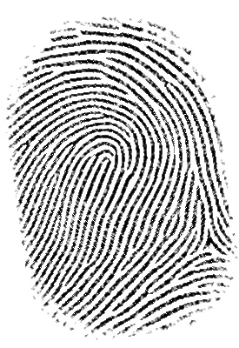
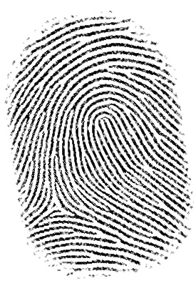
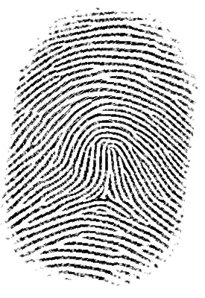
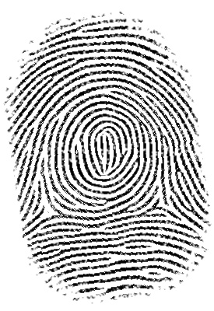
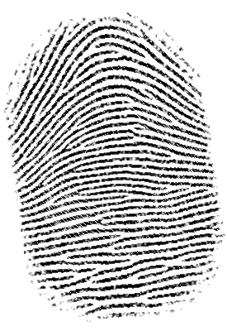
We feed the model with two types of fingerprints, say whorl and arch. Aim is to convert whorl into arch. G is converting real whorl into fake arch, and D is differentiating between fake converted arch and real arch fingerprints.
This way we are able to convert real whorl fingerprint into a real looking fake arch fingerprint.
Arch
Left loop
Right loop
Tented Arch
Whorl

Slide 11
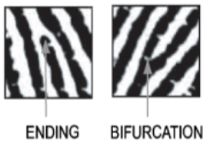
Fingerprint Matching
Different fingerprints are matched using level 2 features- Bifurcations and endings, also called Minutiaes

Slide 12
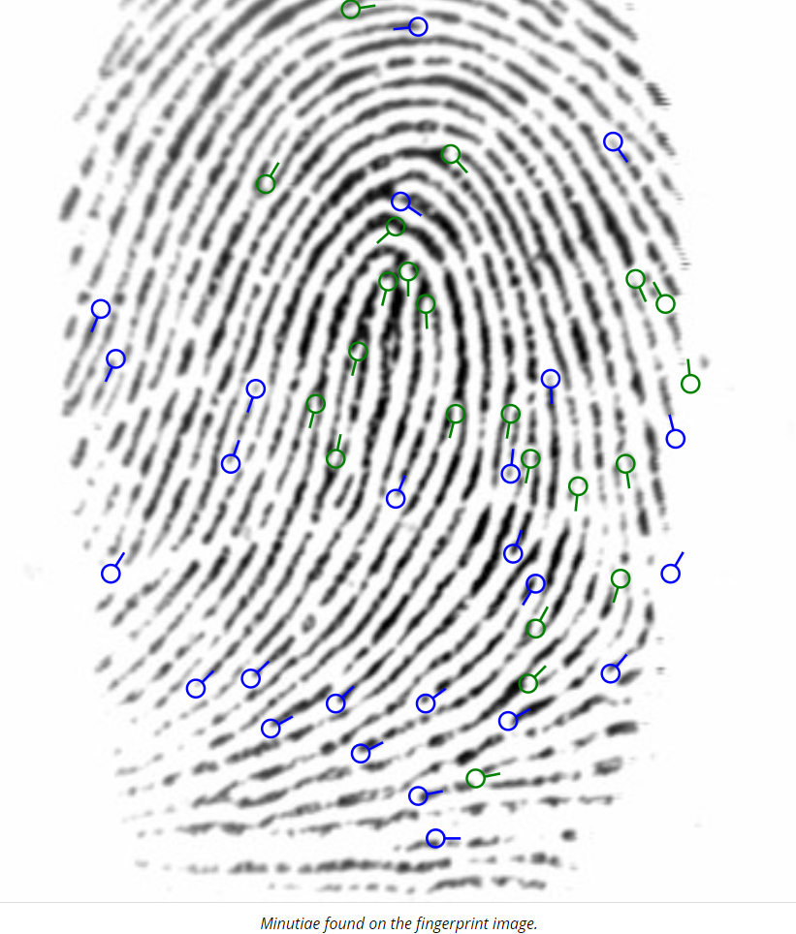
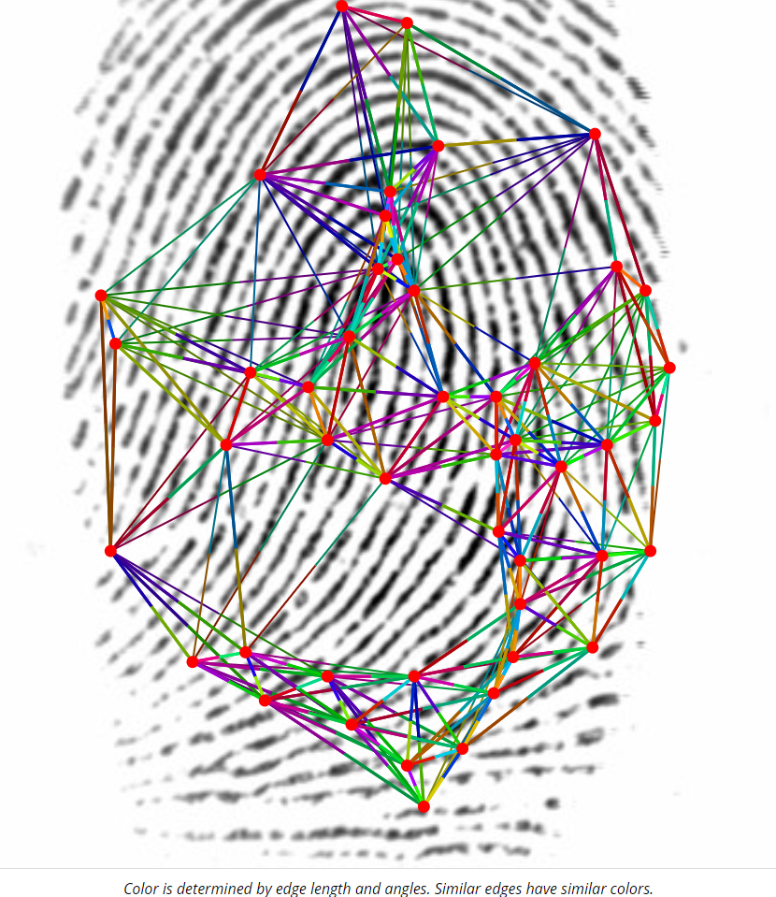
Graph determined using angles and distance between minutiaes
Finding Minutiaes

Slide 13
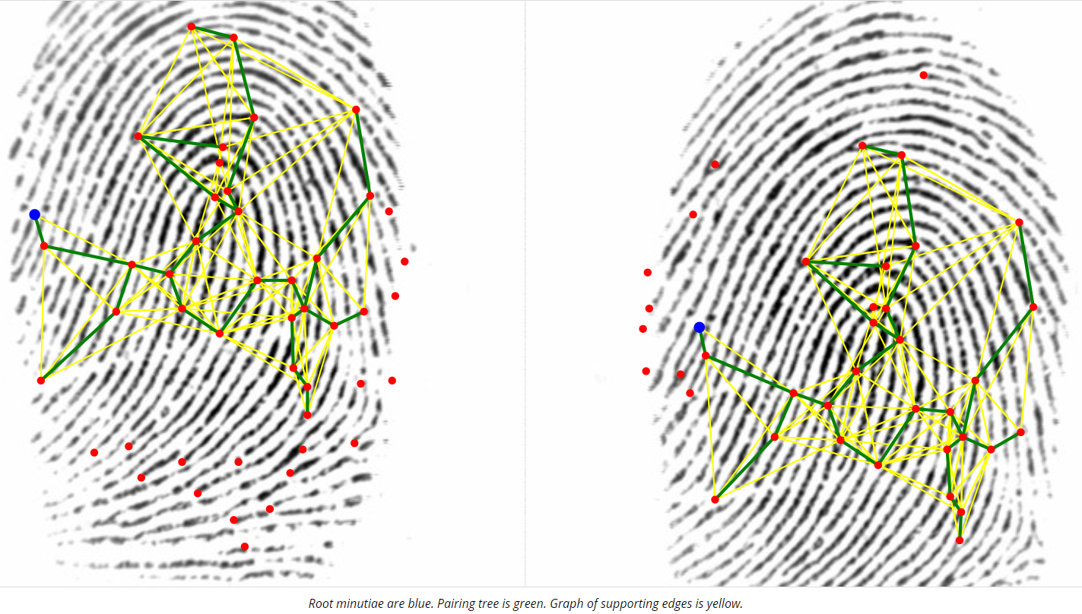
Fingerprints match when the graphs are similar

Slide 14
Algorithm steps
Registration of a new user follows these steps
Detection of the user’s fingerprint. Fingerprint is enhanced using Gabor filter.
The fingerprint is classified into one of the 5 classes of fingerprints, say type 1.
A class of fingerprint different from type 1 is selected randomly, say type 2. Type 2 is the class which the final fake fingerprint will belong to.
A cycle gan model has been trained on all type conversions.
A random key is selected. This key is a fingerprint which is taken from the key database. Can be of any type.
Latent space of real fingerprint and key are added using linear regression, then passed through resnet (decoder) to get the fake fingerprint.
Fake fingerprint is enhanced using gabor filter.
Heat map is used to crop the fake fingerprint.
Harris corner detection is used to find scores between RF and FF. It is made sure that the score between both is lower than threshold. Otherwise a new key image and a new type for FF (Type 2) is chosen for the user.
This FF is stored in the database.
When the user signs in henceforth, his RF and key will be taken as input and converted to FF. This new generated FF will be matched with the database of stored FFs. If a match is found, user is given access.

Slide 15
Keys and Latent space
The vector input to the GAN architecture is the latent space of the input. We use this vector to generate different images from the input. The latent space of user’s RF is modified using key’s latent space.
The modification is done using linear regression to get the optimized result which does not match the RF or the key.
The objective function for optimization is =
0.3*(feature difference between modified gan image and source image) + 0.3*(feature difference between modified gan image and key image) + 0.4*(classification probability score predicted by trained classification model)
The objective function is a pay off between altering the feature points but also preserving the overall shape of a fingerprint belonging to the particular class.
Different keys can be used to generate different outputs. Multiple keys can be associated with a single user.

Slide 16
Heat map activation
https://keras.io/examples/vision/grad_cam/
https://www.pyimagesearch.com/2020/03/09/grad-cam-visualize-class-activation-maps-with-keras-tensorflow-and-deep-learning/
Using Grad-CAM, we can visually validate where our network is looking, verifying that it is indeed looking at the correct patterns in the image and activating around those patterns.
Grad-CAM works by (1) finding the final convolutional layer in the network and then (2) examining the gradient information flowing into that layer.
The output of Grad-CAM is a heatmap visualization for a given class label (either the top, predicted label or an arbitrary label we select for debugging). We can use this heatmap to visually verify where in the image the CNN is looking
This concept has been used to crop our final images to accommodate most contributing pixels and neglecting others.

Slide 17
Validation of results
Intra user- Results show that intra user scores of a user are preserved
Inter user- Results show that inter user scores of users are preserved
Frequency spectrum- The fake fingerprints are not distinguishable from real fingerprint using frequency graph. Both RF and FF give same frequency spectrum.
DET Graph- The results are shown graphically using DET graph. We can decide on the threshold using this graph.

Slide 18
Datasets used
Anguli MSVC: 1200 total fingerprints of each type, used

Slide 19
Illustration of all conversions
We have five types of fingerprints
Arch
Left loop
Right loop
Tented Arch
Whorl
The conversions will be from each type of fingerprint to every other type vv

Slide 20
Types of fingerprints
Arch
Left loop
Right loop
Tented Arch
Whorl

Slide 21
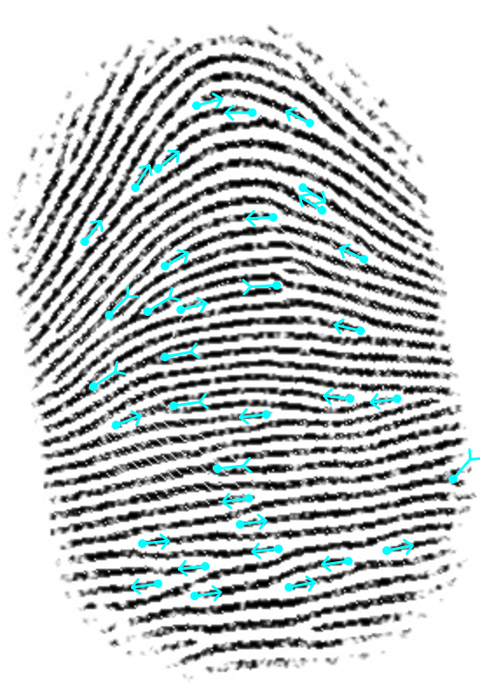
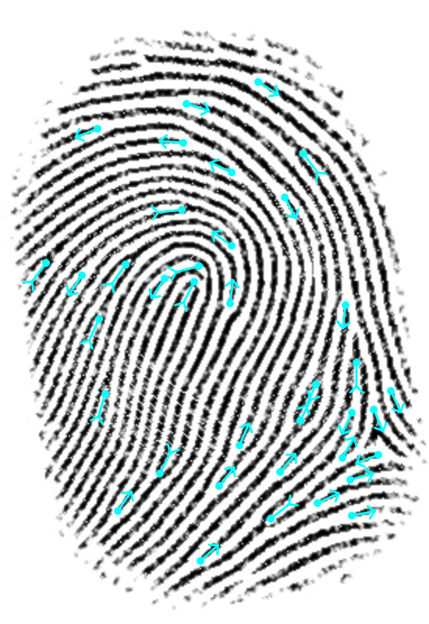
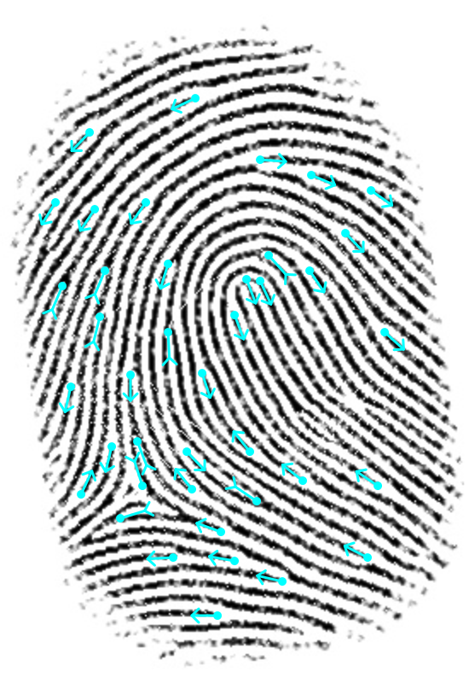
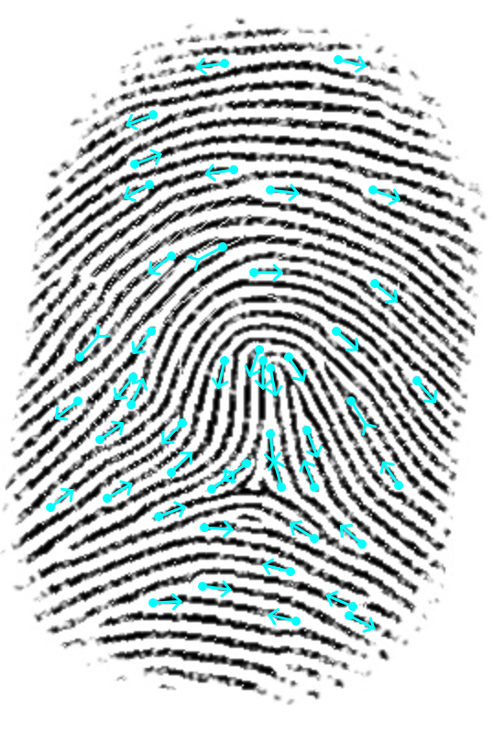
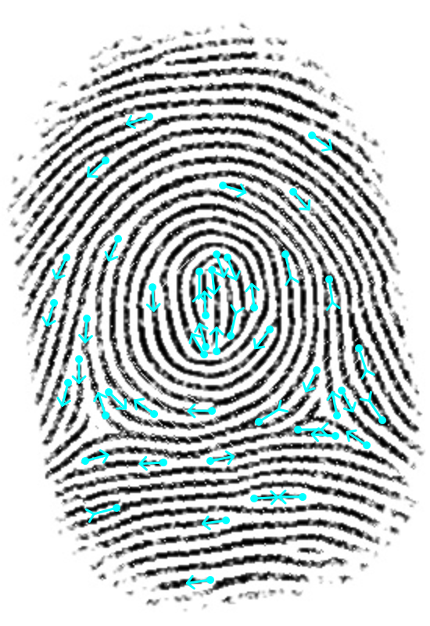
Illustrations of their minutiaes
Arch
Left loop
Right loop
Tented Arch
Whorl

Slide 22
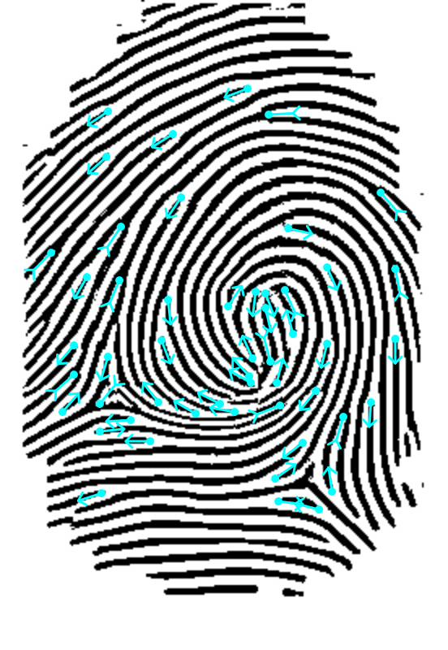
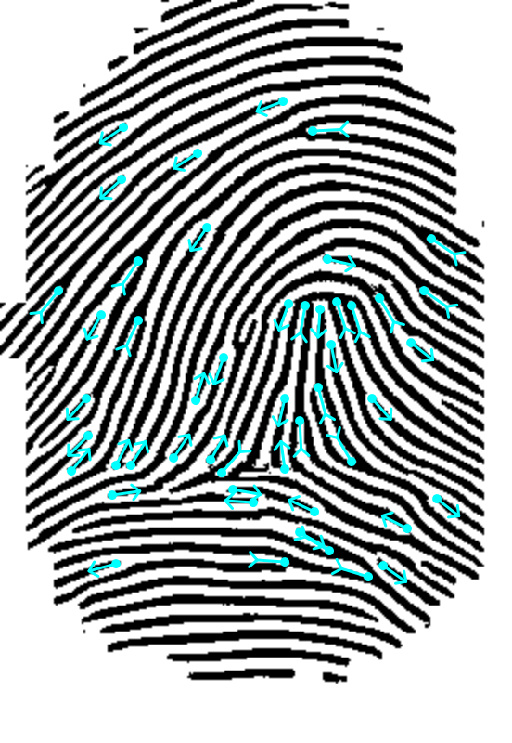
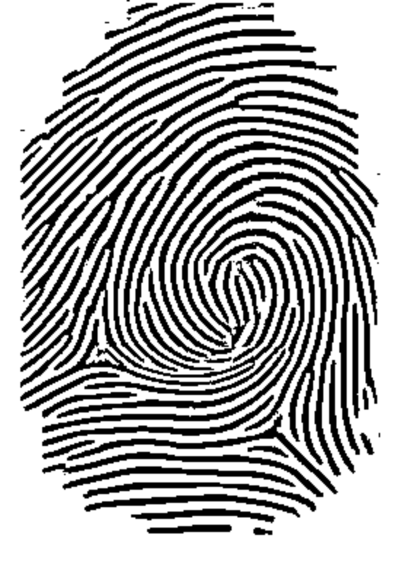
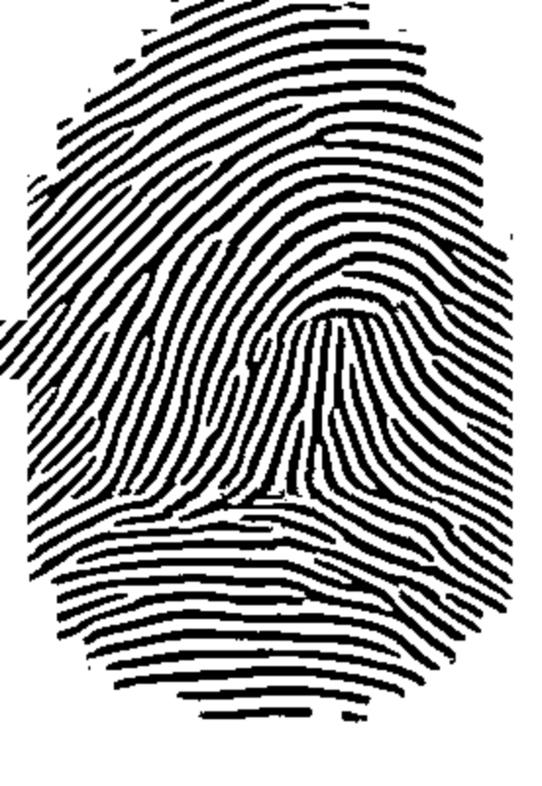
Example of a conversion
Minutiae Mask Real fp Arch
Minutiae Mask Fake fp Tented Arch
Real fp: Whorl
Fake fp: Tented Arch

Slide 23
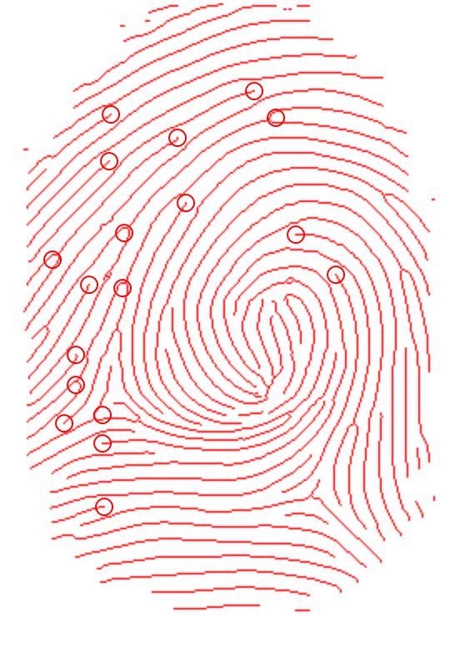
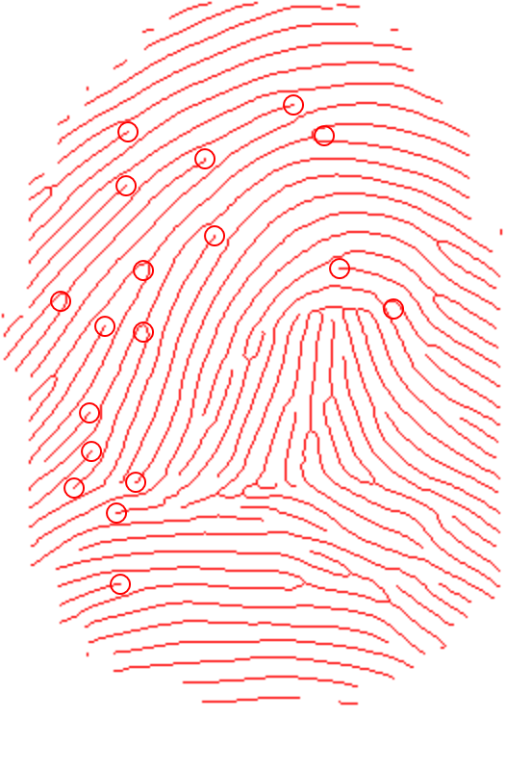
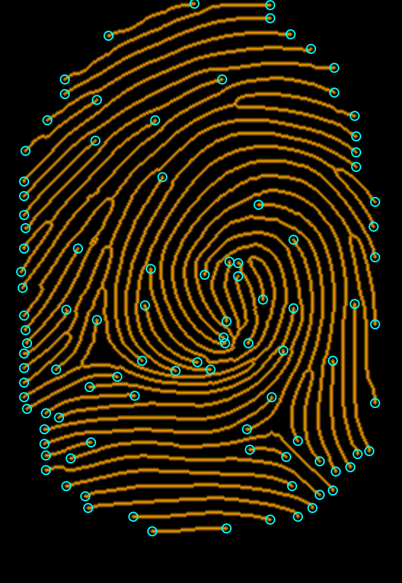
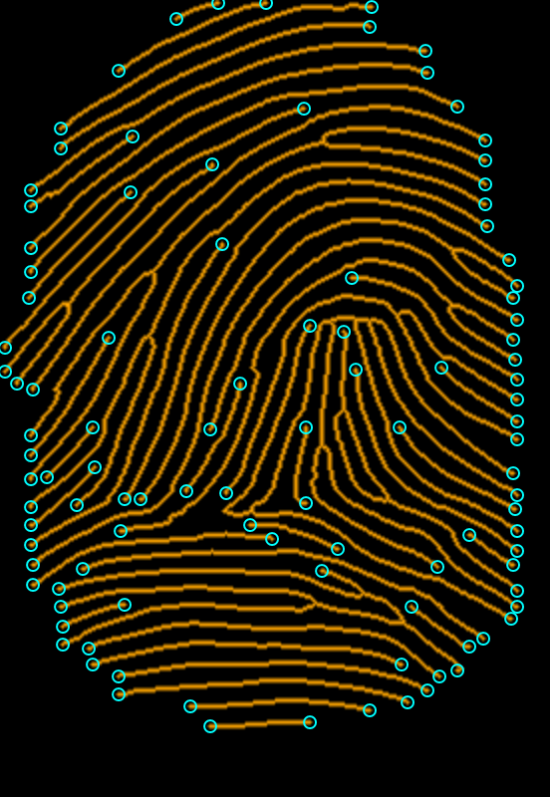
Illustration of their Minutiaes
All minutiaes of real fp Whorl
All minutiaes of fake fp Tented Arch
Real fp
Fake fp
Common minutiaes of both fingerprints

Slide 24
Intra user variation
Two goals:
Scores between the real and fake fingerprint should be low
Different impressions of same fingerprint should produce same fake fingerprint. This is verified by matching scores between real impressions and their fake conversions.
Example showed by converting two impressions of same fingerprint to same type and matching their scores - Whorl to Right type conversion

Slide 25
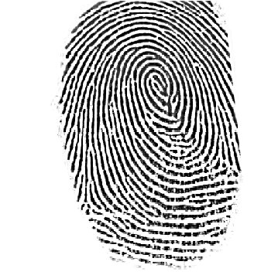
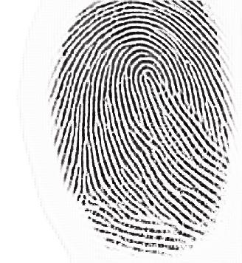
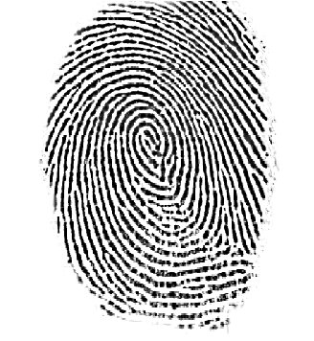
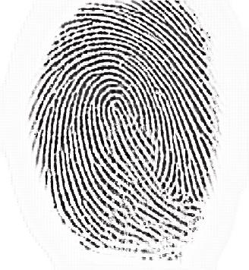
Steps for showing image matching
Person 1
Impression 1
Real
Whorl
Person 1
Impression 1
Fake
Right loop
Conversion
Conversion
Person 1
Impression 2
Real
Whorl
Person 1
Impression 2
Fake
Right loop

Slide 26
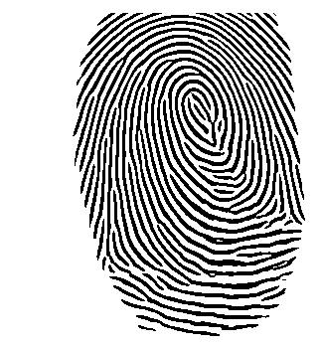
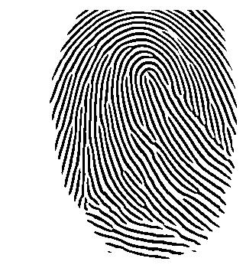
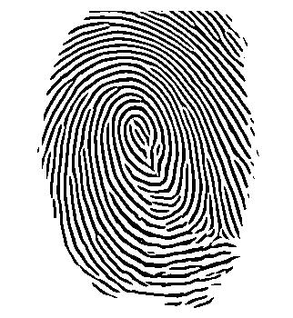
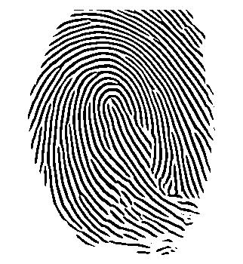
Person 1
Impression 1
Real
Whorl
Person 1
Impression 1
Fake
Right loop
Conversion
Conversion
Person 1
Impression 2
Real
Whorl
Person 1
Impression 2
Fake
Right loop

Slide 27
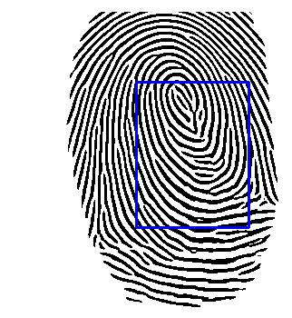
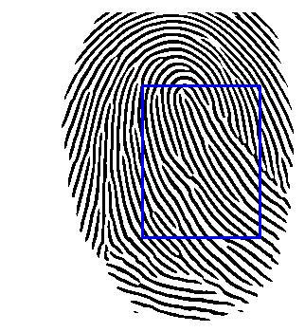
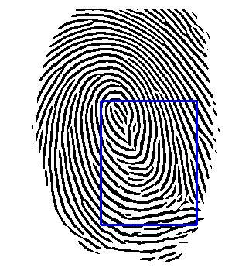
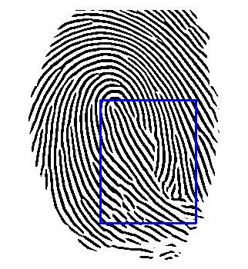
Person 1
Impression 1
Real
Whorl
Person 1
Impression 1
Fake
Right loop
Conversion
Conversion
Person 1
Impression 2
Real
Whorl
Person 1
Impression 2
Fake
Right loop

Slide 28
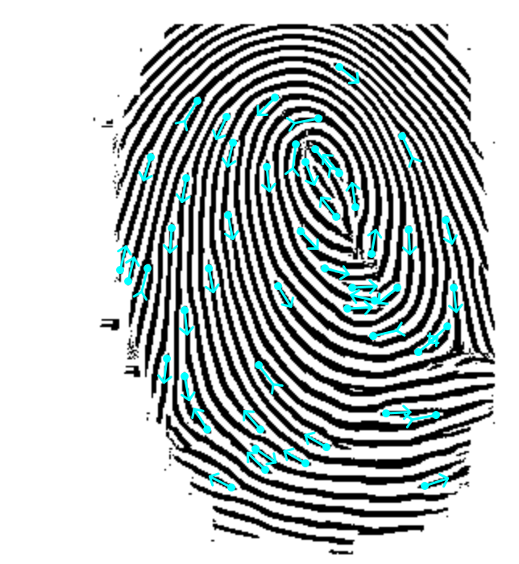
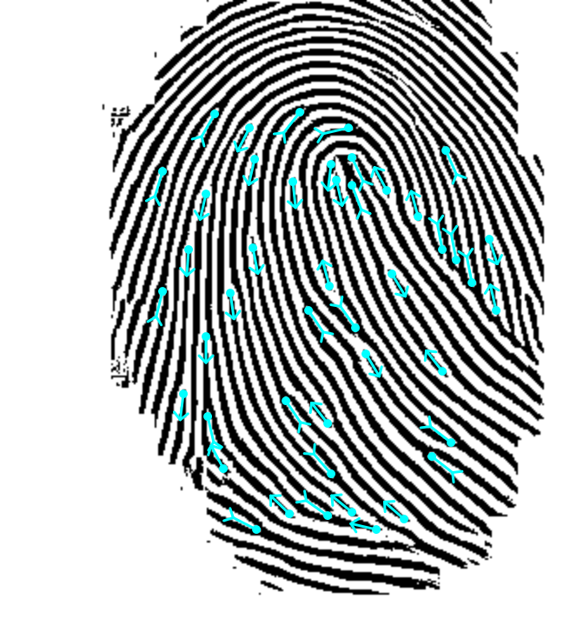
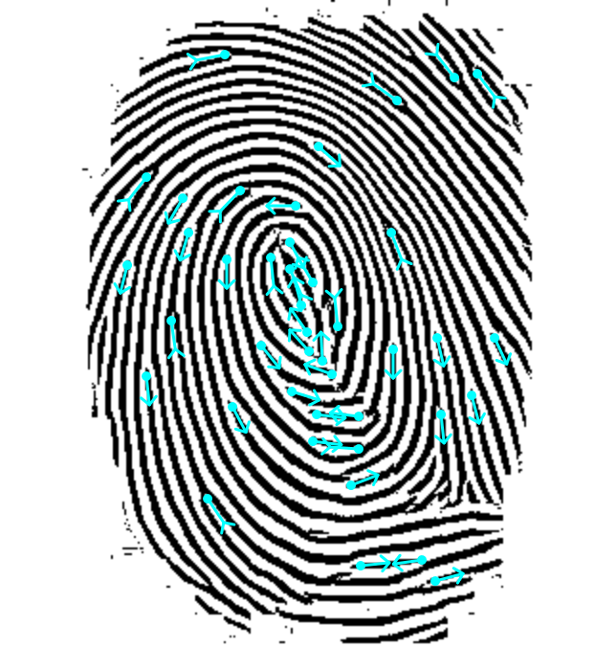
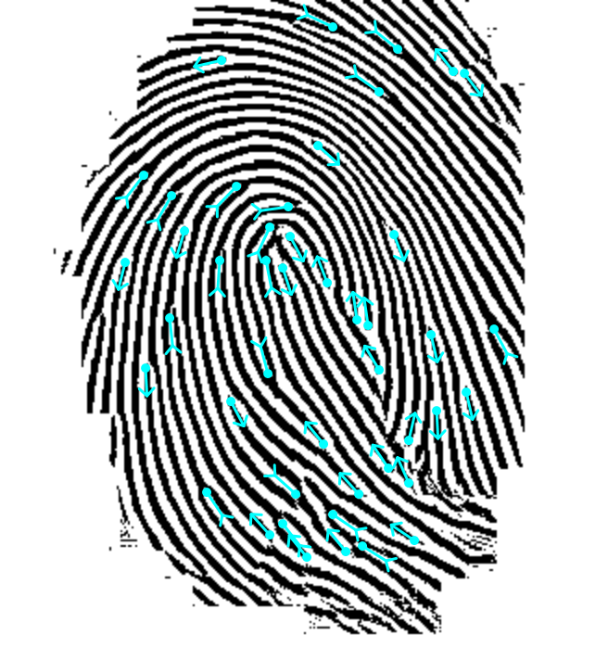
Person 1
Impression 1
Real
Whorl
157
Person 1
Impression 1
Fake
Right loop
Conversion
349
176
119
Conversion
Person 1
Impression 2
Real
Whorl
Person 1
Impression 2
Fake
Right loop

Slide 29
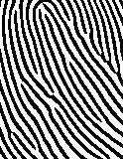
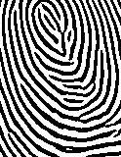
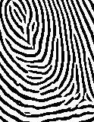
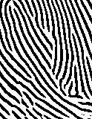
Cropped scores
Person 1
Impression 1
Real
Whorl
Person 1
Impression 1
Fake
Right loop
Conversion
34
197
70
Conversion
Person 1
Impression 2
Real
Whorl
Person 1
Impression 2
Fake
Right loop
2

Slide 30
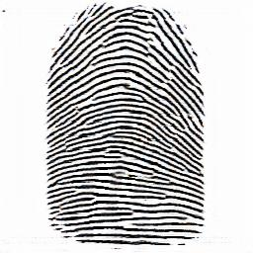
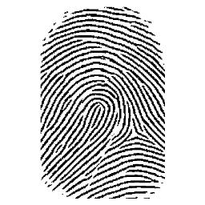
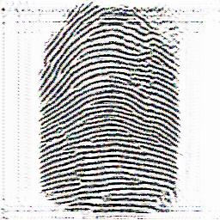
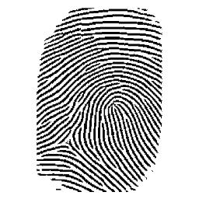
IMPORTANCE OF USING KEY IMAGE
Person 1
Impression 1
Real
Conversion with simple cycle gans
Person 1
Impression 1
Fake
20
48- score between both fake image
Conversion with modified cycle gans (key image)
Person 1
Impression 2
Fake
With key
25

Slide 31


INTRA USER SCORES without KEY
Person 1
Impression 1
Real
Person 1
Impression 1
Fake
Without key
Conversion
19
225- score between 2 impressions
92- score between 2 fake impressions
Conversion
Person 1
Impression 2
Real
21
Person 1
Impression 2
Fake
Without key

Slide 32

INTRA USER SCORES with KEYS
Person 1
Impression 1
Real
Person 1
Impression 1
Fake
With key
24
Conversion
Key image
89- score between 2 impressions with keys
225- score between 2 impressions
Conversion
Person 1
Impression 2
Real
Person 1
Impression 2
Fake
With key
18

Slide 33
Table
Scores between 6 impressions of same person
Person 1 | 1 | 2 | 3 | 4 | 5 | 6
1 | 8 | 193 | 212 | 215 | 246 | 271
2 | 91 | 34 | 197 | 224 | 241 | 256
3 | 82 | 110 | 2 | 217 | 235 | 230
4 | 99 | 128 | 97 | 4 | 264 | 221
5 | 97 | 113 | 85 | 75 | 34 | 261
6 | 102 | 158 | 111 | 101 | 155 | 29
 | Real and fake
 | Real and real
 | Fake and fake

Slide 34
Inter user variation
Two goals:
Scores between the real and fake fingerprint should be low
Impressions of different fingerprint should produce different fake fingerprint. This is verified by matching scores between real impressions and their fake conversions.
Example showed by converting two impressions of different fingerprint to same type and matching their scores - Whorl to Right type conversion

Slide 35


Steps for showing image matching
Person 1
Impression 1
Real
Whorl
Person 1
Impression 1
Fake
Right loop
Conversion
Conversation
Person 2
Impression 1
Real
Whorl
Person 2
Impression 1
Fake
Right loop

Slide 36


Person 1
Impression 1
Real
Whorl
Person 1
Impression 1
Fake
Right loop
Conversion
Conversion
Person 2
Impression 1
Real
Whorl
Person 2
Impression 1
Fake
Right loop

Slide 37




Person 1
Impression 1
Real
Whorl
Person 1
Impression 1
Fake
Right loop
Conversion
Conversion
Person 2
Impression 1
Real
Whorl
Person 2
Impression 1
Fake
Right loop

Slide 38


Person 1
Impression 1
Real
Whorl
Person 1
Impression 1
Fake
Right loop
Conversion
174
7
43
Conversion
Person 2
Impression 1
Real
Whorl
Person 2
Impression 1
Fake
Right loop
114

Slide 39




Cropped scores
Person 1
Impression 1
Real
Whorl
Person 1
Impression 1
Fake
Right loop
Conversion
2
8
25
Conversion
Person 2
Impression 1
Real
Whorl
Person 2
Impression 1
Fake
Right loop
3

Slide 40

INTER USER SCORES without KEY
Person 1
Impression 1
Real
Whorl
19
Person 1
Impression 1
Fake
Without key
Conversion
62- score between 2 impressions of 2 people
52- score of 2 fake impressions of 2 people without key
Conversion
Person 2
Impression 1
Real
Whorl
Person 2
Impression 1
Fake
Without key
21

Slide 41
INTER USER SCORES with KEYS
Person 1
Impression 1
Real
Whorl
26
Person 1
Impression 1
Fake
With key
Conversion
Key image
62- score between 2 impressions of 2 people
48- score between 2 fake fingerprints of 2 people with key
Conversion
Person 2
Impression 1
Real
Whorl
Person 2
Impression 1
Fake
With key
25

Slide 42
Table
Scores between 6 impressions of two different person
Person 1 and person 2 | 1 | 2 | 3 | 4 | 5 | 6
1 | 14 | 3 | 6 | 2 | 2 | 3
2 | 2 | 6 | 2 | 1 | 2 | 5
3 | 24 | 4 | 2 | 6 | 4 | 8
4 | 6 | 11 | 8 | 11 | 5 | 4
5 | 5 | 8 | 9 | 10 | 5 | 2
6 | 12 | 9 | 25 | 4 | 17 | 3
 | Real and fake
 | Real and real
 | Fake and fake

